Slide 1
National Expenditures
The current Gross Domestic Product is 14.1 Trillion. (Source: World Bank)
Total Federal Spending plan 2011 – 3.83 Trillion (Source: (usgovernmentspending.com)
US Health Care Spending 2011-17.4% GDP, 2.3 Trillion (Source: KFF (http://www.kaiseredu.org/Issue-Modules/US-Health-Care-Costs/Background-Brief.aspx ) KFF Estimate for Chronic Disease: health care costs for chronic disease treatment account for over 75% of national health expenditures)

Slide 2
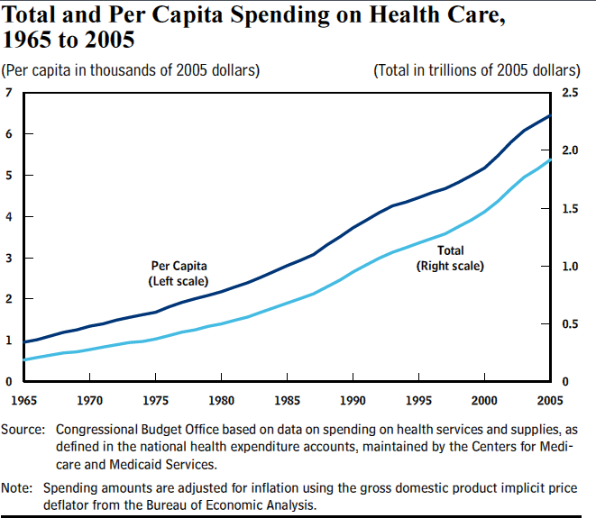

Slide 3
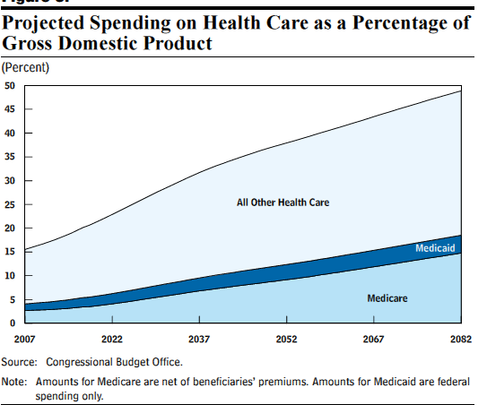

Slide 4
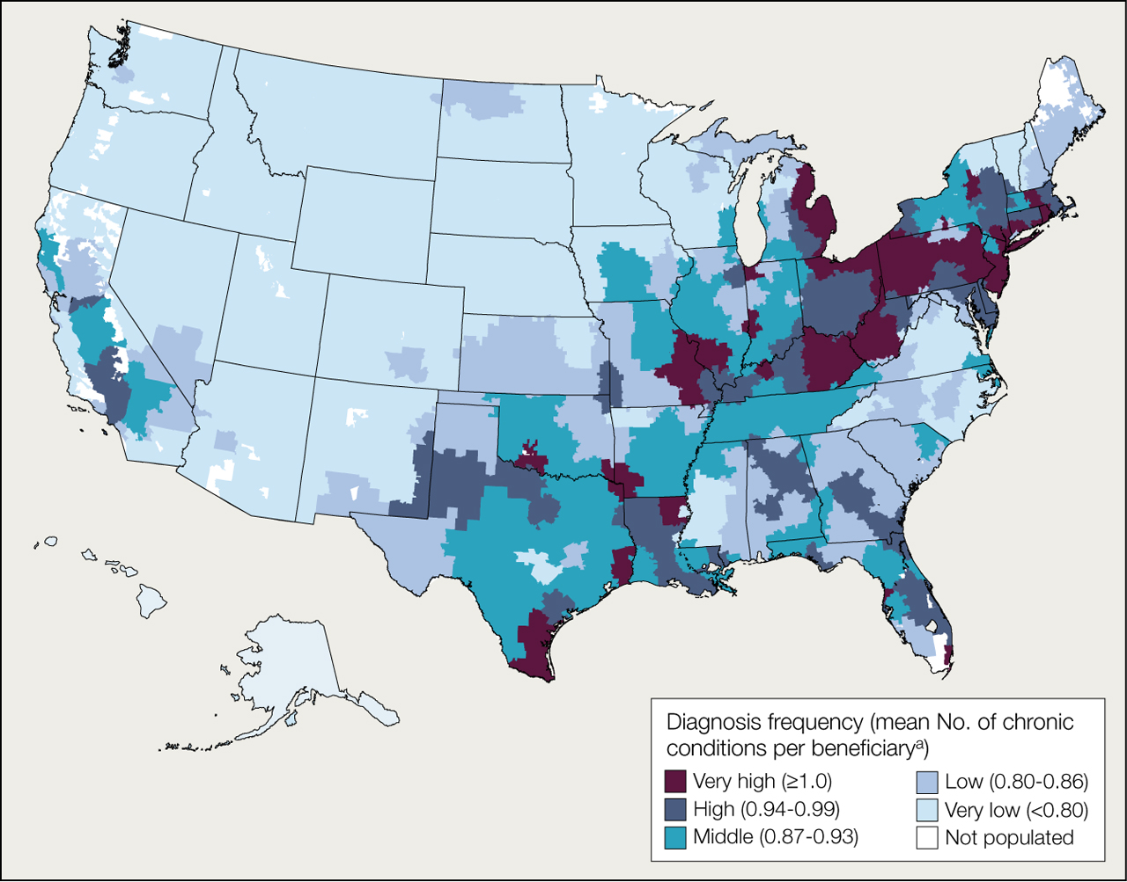

Variation in Number of Chronic Conditions Diagnosed Among Medicare Beneficiaries in the United States, 2007
Welch, H. G. et al. JAMA 2011;305:1113-1118
Copyright restrictions may apply.
Notes:
aValues in parentheses indicate range for each quintile.

Slide 5
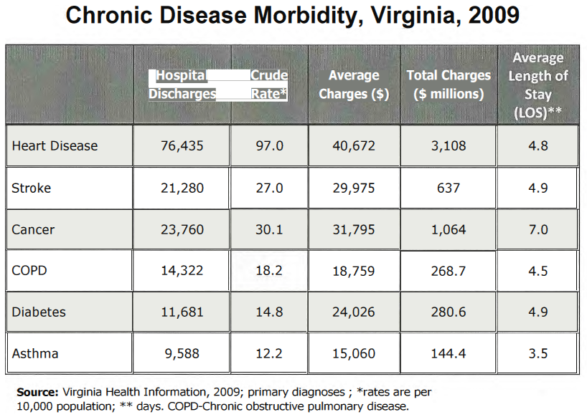

Slide 6
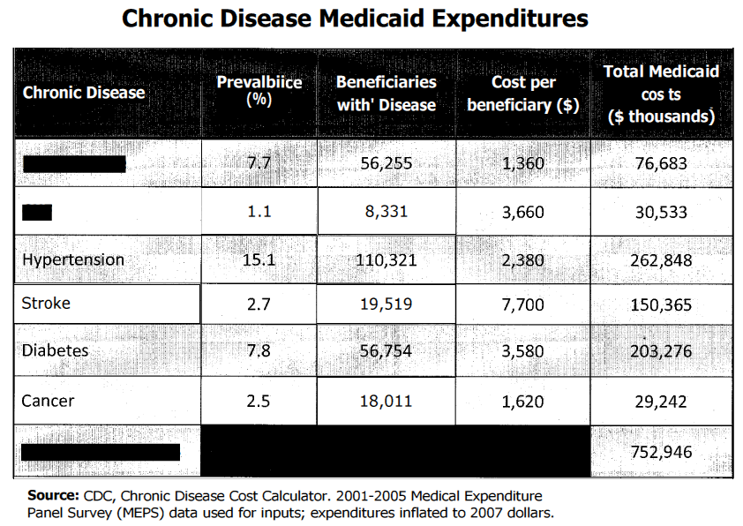

Slide 7
